Slide 1



COLUMBIA ASIA
HOSPITAL
-KAVYA R

Slide 2

INTRODUCTION
OBJECTIVES
DATA ANALYSIS
RECOMMENDATIONS
SUBJECTIVE ANALYSIS
CONCLUSIONS

Slide 3
INTRODUCTION
Columbia Asia Hospital is a leading multi-specialty healthcare provider with a 300-bed capacity, serving a diverse patient population.
Data Scope:
Analysis covers 9,216 visits (2019–2020), including:
Patient demographics (age, gender, race)
Operational metrics (wait times, department referrals)
Financial data (revenue per visit, billing trends)
Patient satisfaction (scores, feedback trends)
Key Challenges Identified:
High wait times (avg. 35.25 mins), especially in Neurology (36.8 mins)
Patient dissatisfaction (avg. score 5.9/10), with teens (5.77) and Asian males in Renal (3.17) scoring lowest
Revenue concentration in General Practice (80%), indicating untapped potential in other departments

Slide 4
OBJECTIVES
Identify top revenue-generating departments
Reduce wait times by 10%
Increase satisfaction score to 6.5
Optimize services for middle-aged patients
Address racial disparities in care
Rebalance staff across shifts
Design targeted discount programs

Slide 5
DATA CLEANING
patient_sat_score had missing values. These were imputed with the average satisfaction score (e.g., 5), using conditional replacement logic to avoid data loss.
Split the date column into separate visit_date and visit_time columns.
Converted visit_date to proper Date format and visit_time to Time format.
Columns like patient_age, patient_waittime, and patient_sat_score were converted to appropriate numeric types.
Checked and removed duplicate patient IDs with identical records using Power Query.
Merged the Hospital ER CSV data with the Doctor_Patients_data Excel table using patient_id to analyze patient visits along with billing and doctor info.

Slide 6
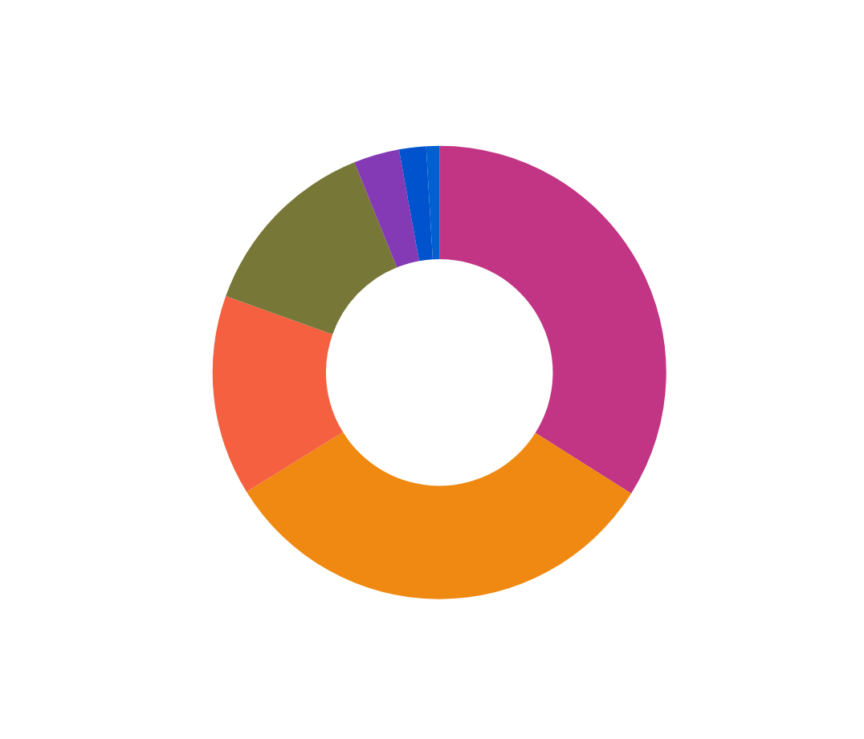
TOTAL REVENUE BY DEPARTMENT
General Practice generates ~₹40.7Cr (80% of revenue from 7,220 visits)
Orthopedics contributes ₹5.5Cr from 992 visits (higher revenue/visit than average)
Neurology has highest revenue/visit despite fewer patients
Recommendations:
Monetize General Practice further with preventive care packages
Premium pricing for Neurology services

Slide 7
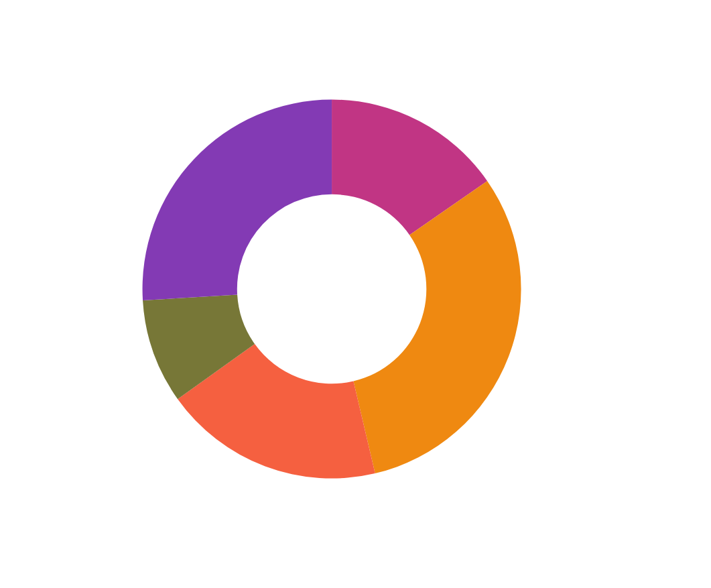
TOTAL PATIENTS BY AGE GROUP
Middle-aged dominate (31%, 2,848 patients)
Young Adults are 2nd largest (26%, 2,386 patients)
Teens are most underserved (9%, 819 patients)
Recommendations:
Launch chronic disease management for Middle-aged
Teen health awareness campaigns

Slide 8

TOTAL BILL BY MONTH
August 2020 peak (₹5.3Cr from 527 visits)
February 2020 dip (₹4.2Cr from 428 visits)
Stable ₹4.6-5.3Cr monthly range
Recommendations:
Seasonal promotions in low months
Annual wellness packages to stabilize cash flow

Slide 9
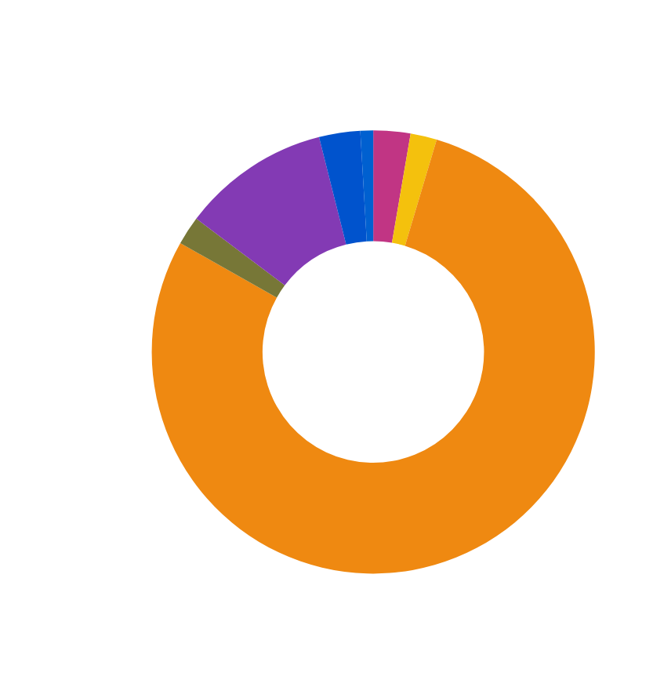
TOTAL PATIENTS BY DEPARTMENT
General Practice handles 78% visits (7,220)
Orthopedics is distant 2nd (992 visits)
Physiotherapy is least utilized (276 visits)
Recommendations:
Redirect Orthopedics overflow to Physiotherapy
Promote Physiotherapy for preventive care

Slide 10
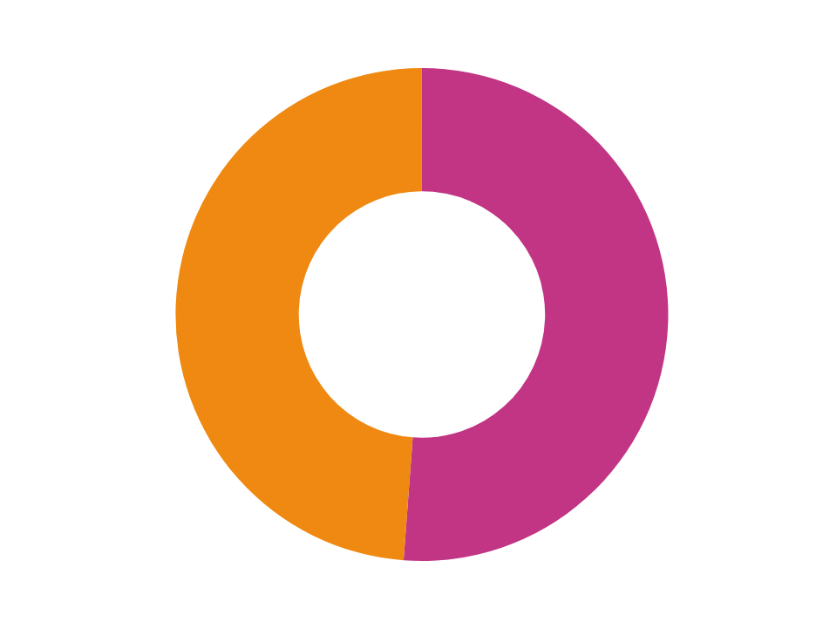
NUMBER OF VISITS BY GENDER
Near-perfect 51% Male / 49% Female split
Males dominate Orthopedics (162M vs 147F in Middle-aged)
Recommendations:
Gender-specific orthopedic wellness programs
Monitor for referral bias

Slide 11

PATIENT SATISFACTION SCORE PER DOCTOR

Slide 12
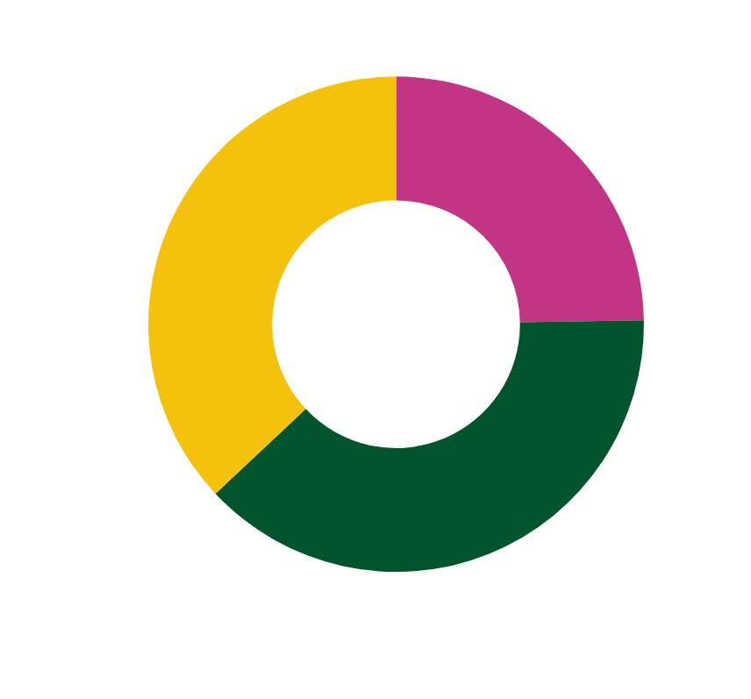
NUMBER OF VISITS BY SHIFTS
Insights:
Shift A handles most visits (2,762)
Off-hours still significant (1,787 visits)
Balanced distribution between shifts
Recommendations:
Optimize staffing for Shift A peak
Incentivize off-hours utilization

Slide 13
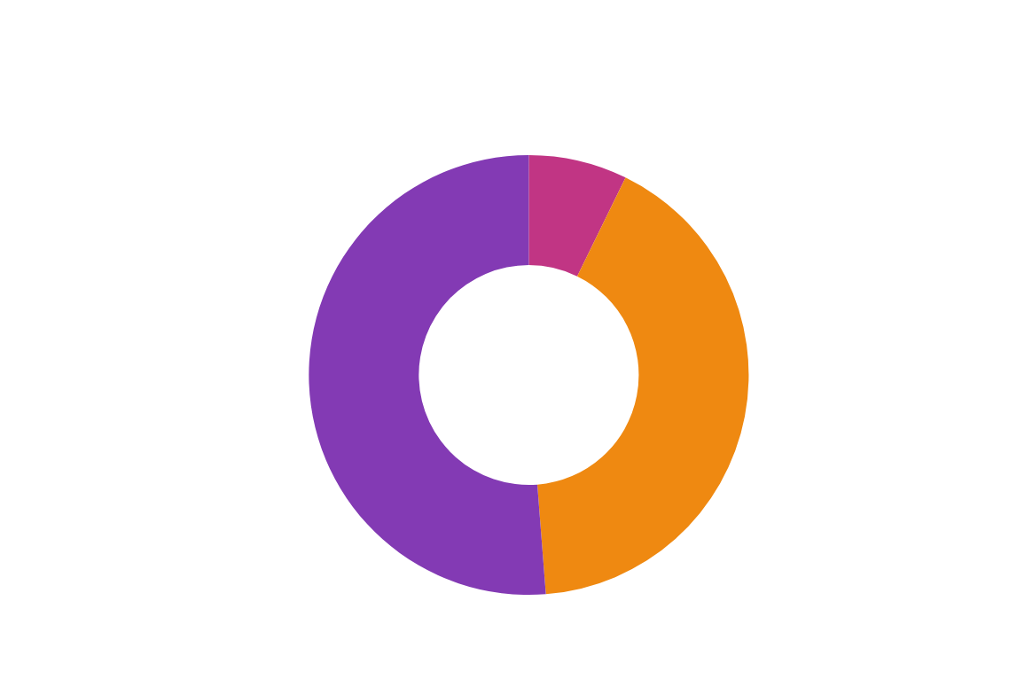
DISCOUNTS ANALYSIS
Insights:
Medium discounts most common (911 cases)
High discounts least used (129 cases)
Strong correlation between discounts and satisfaction improvement
Recommendations:
Expand medium discount programs
Targeted high discounts for at-risk groups

Slide 14
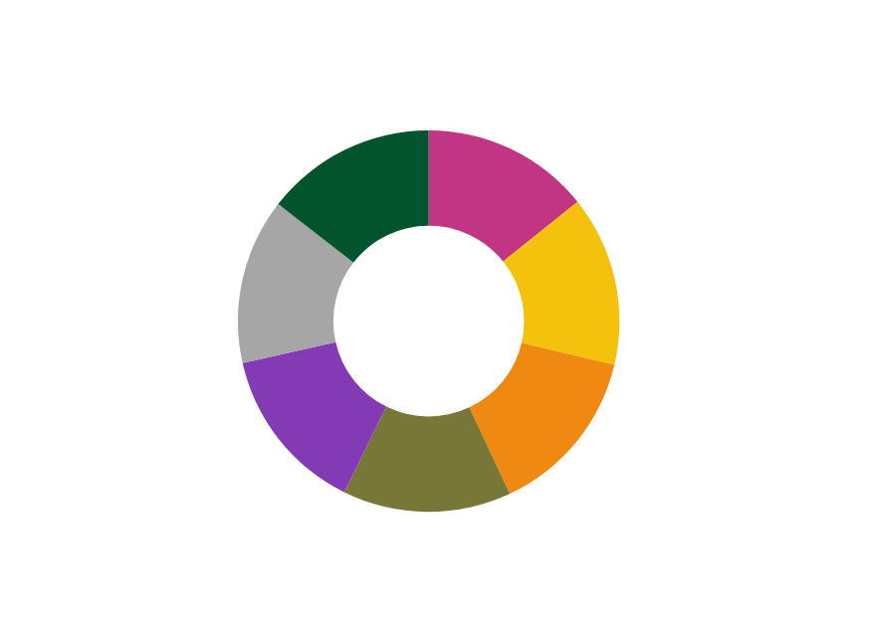
PATIENT RACE VS AVG WAIT TIME
Insights:
Native American patients have the highest wait time → 35.69 mins
African American patients also experience above-average delays → 35.58 mins
Pacific Islander patients have the lowest wait time → 34.64 mins
Recommendations:
Prioritize operational improvements in departments with higher wait times for Native American & African American patients.
Implement fast-track check-in or express consultation options for at-risk groups.

Slide 15
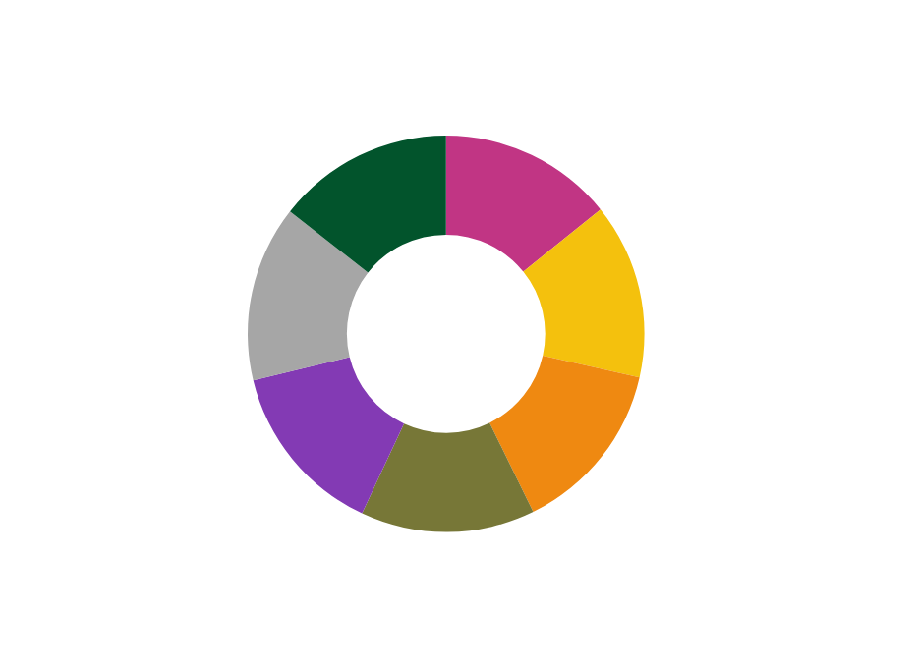
PATIENT RACE VS AVG SATISFACTION
Insights:
All racial groups report satisfaction scores close to 5.9 on average.
Native American (5.96) and Pacific Islander (5.94) patients report the highest satisfaction.
Asian and White patients have slightly lower satisfaction (~5.87), but the difference is minor.
Recommendations:
Maintain inclusive patient engagement practices across all racial groups.
Investigate department-wise patterns to understand subtle satisfaction differences.

Slide 16
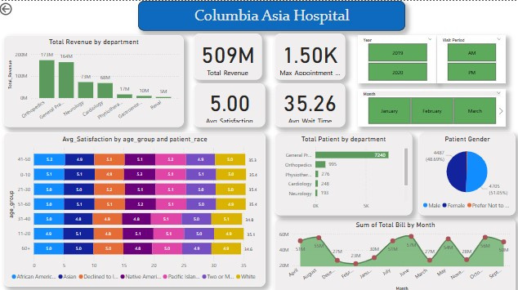

Slide 17
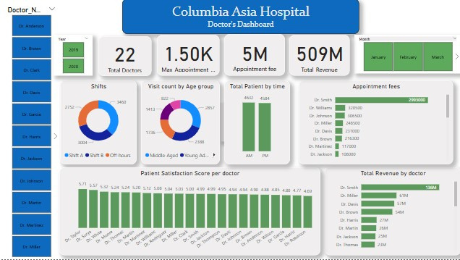

Slide 18
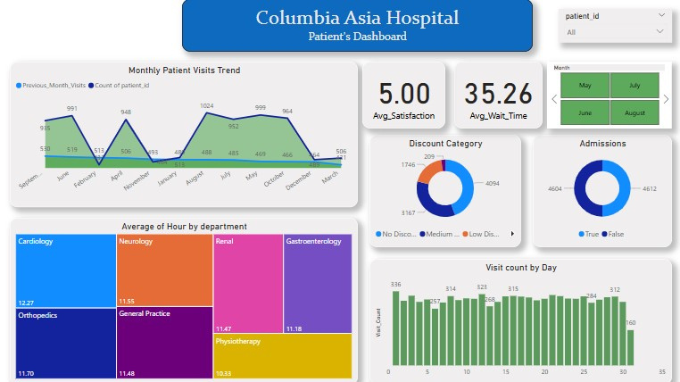

Slide 19
CONCLUSION
General Practice drives volume, Neurology drives profit
Neurology/Physiotherapy need process redesign
Targeted interventions required for teens/Asian males
Shift A requires 20% more resources
Medium discounts most effective
Quick wins: Teen clinics + neurologist hire
1-min wait reduction → 0.2 satisfaction gain

Slide 20
Thank
You

